Slide 1


Data Structures
ETCCDS202
Dr. Aarti
Faculty
School of Engineering & Technology
K.R. Mangalam University
Unit 2 : Linear Data Structures

Slide 2

Unit-2 Linear Data Structures
SESSION 11 Arrays – 1D & 2D
SESSION 12 Static & Dynamic Arrays
SESSION 13 Linked Lists Types
SESSION 14 Linked List Operations
SESSION 15 Stack ADT & Operations
SESSION 16 Stack Applications
SESSION 17 Queue ADT
SESSION 18 Queue Applications
SESSION 19 BFS using Queue
SESSION 20 Revision (Unit–2)
Notes:
New Courses replaced with New Programmes

Slide 3
Stack Applications
Session 16
Introduction to Stack Applications
Why Stack is Suitable for Problem Solving (LIFO)
Applications of Stack – Overview
Expression Evaluation Using Stack
Expression Conversion Using Stack
Algorithms for Expression Conversion
Evaluation of Prefix & Postfix Expressions
Reversing Data Using Stack
Function Calls & Call Stack
Backtracking – Tower of Hanoi
Key Takeaways
Quick Quiz
References
Notes:
New Courses replaced with New Programmes

Slide 4
Recapitulation (Stack ADT and Operations)
A stack is a linear data structure that follows the LIFO (Last In, First Out) principle.
All insertions and deletions occur only at one end called the TOP.
Basic stack operations are: push, pop, peek/top, isEmpty, isFull.
Implemented using arrays (fixed size) or linked lists (dynamic size).
Notes:
New Courses replaced with New Programmes

Slide 5
Quick Quiz
Stack follows the __________ principle.
The end of the stack where insertion and deletion occur is called the __________.
The operation used to insert an element into a stack is called __________.
Stack underflow occurs when we try to __________ from an empty stack.
Name the operation that removes the top element of the stack.
Which data structure is used to implement a dynamic stack?
Notes:
New Courses replaced with New Programmes

Slide 6
Quick Quiz (Answers)
LIFO
TOP
Push
Pop
Pop
Linked list
Notes:
New Courses replaced with New Programmes

Slide 7
Learning Objectives
After this lecture, students will be able to:
List major applications of stack in data structures
Explain how LIFO helps in solving computational problems
Differentiate between infix, prefix, and postfix expressions
Convert expressions between different notations using stack
Evaluate prefix and postfix expressions using stack algorithms
Notes:
New Courses replaced with New Programmes

Slide 8
Application of Stack in Data Structure are :
Evaluation of Arithmetic Expressions
Reverse a Data
Processing Function Calls
Backtracking (Tower of Hanoi Problem)
Delimiter Checking
Notes:
New Courses replaced with New Programmes

Slide 9
Expression Evaluation Using Stack
An arithmetic expression can be represented as a string consisting of:
Operands (numbers or variables)
Operators (+ , − , * , /)
Parentheses ( )
You may assume that:
All parentheses are well-matched
Only binary operators (+ , − , * , /) are used
Notes:
New Courses replaced with New Programmes

Slide 10
Expression Evaluation Using Stack
Arithmetic expressions can be written in different notations:
Infix Notation – Operator is placed between operands: A + B
Prefix Notation (Polish Notation) – Operator is placed before operands: + A B
Postfix Notation (Reverse Polish Notation) – Operator is placed after operands: A B +
Stacks are commonly used to convert between these notations and to evaluate prefix and postfix expressions efficiently.
Notes:
New Courses replaced with New Programmes

Slide 11
The standard precedence rules for arithmetic expression
Operators | Associativity | Precedence
^ exponentiation | Right to left | Highest followed by *Multiplication and /division
*Multiplication, /division | Left to right | Highest followed by + addition and - subtraction
+ addition, - subtraction | Left to right | lowest
Notes:
New Courses replaced with New Programmes

Slide 12
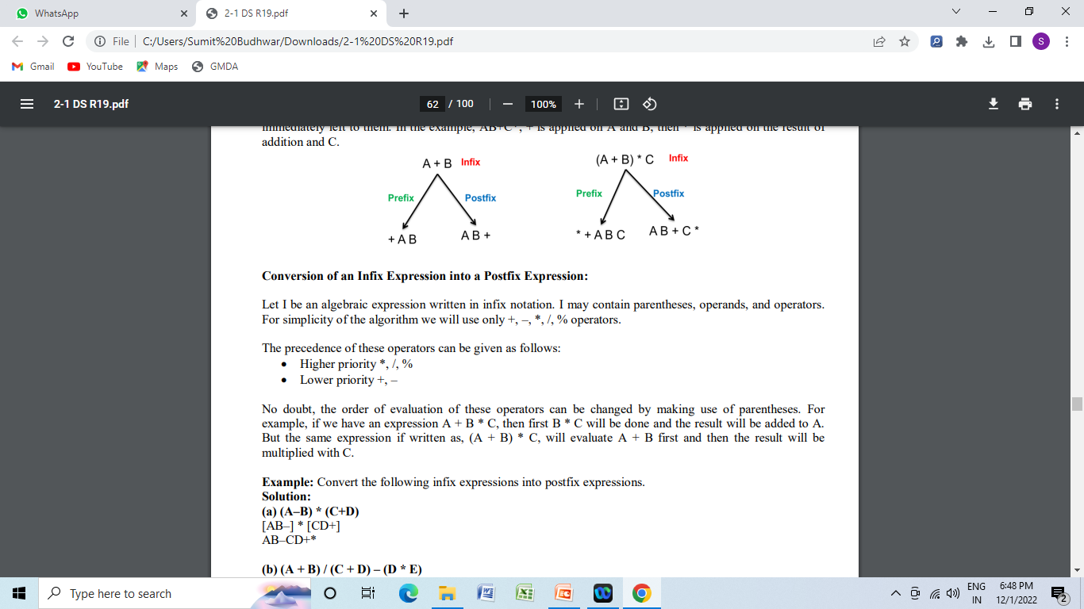
Conversion
Infix to Postfix
Infix to Prefix
Postfix to Prefix
Postfix to In fix
Pre fix to Infix
Pre fix to postfix
Notes:
New Courses replaced with New Programmes

Slide 13
Infix to Postfix
Algorithm for Conversion of Infix to Postfix :
Initialize an empty stack and an empty postfix string.
Scan the infix expression from left to right.
If the symbol is an operand, append it to postfix.
If (, push it onto the stack.
If ), pop and append operators until ( is removed.
If an operator, pop higher or equal precedence operators from stack and append, then push it.
After scanning, pop and append all remaining stack operators.
Output the postfix expression.
Notes:
New Courses replaced with New Programmes

Slide 14
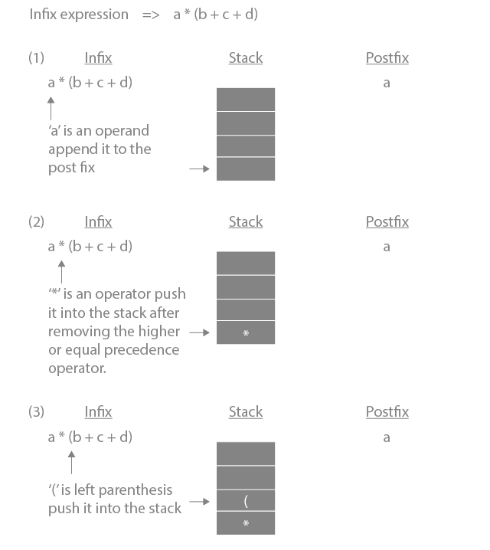
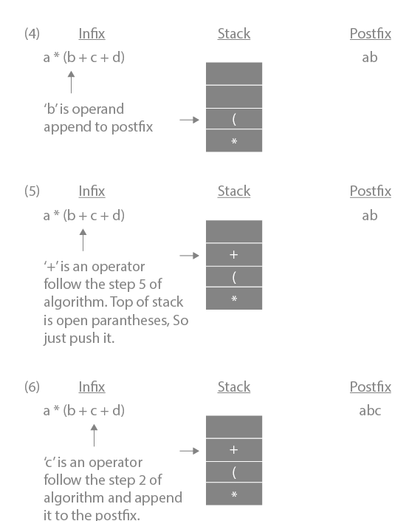
Infix to Postfix
Notes:
New Courses replaced with New Programmes

Slide 15
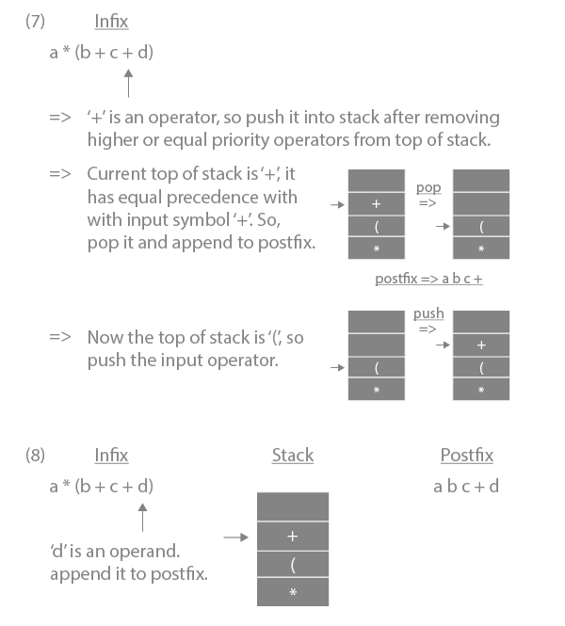
Infix to Postfix
Notes:
New Courses replaced with New Programmes

Slide 16
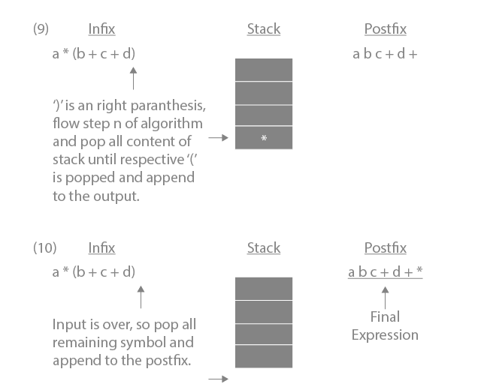
Infix to Postfix
https://www.prepbytes.com/blog/stacks/infix-to-postfix-conversion-using-stack/
Notes:
New Courses replaced with New Programmes

Slide 17
Quick Check
Here is an infix expression: 4 + 3*(6*3-12). Suppose that we are using the usual stack algorithm to convert the expression from infix to postfix notation. The maximum number of symbols that will appear on the stack AT ONE TIME during the conversion of this expression?
a) 1 b) 2 c) 3 d) 4
Notes:
New Courses replaced with New Programmes

Slide 18
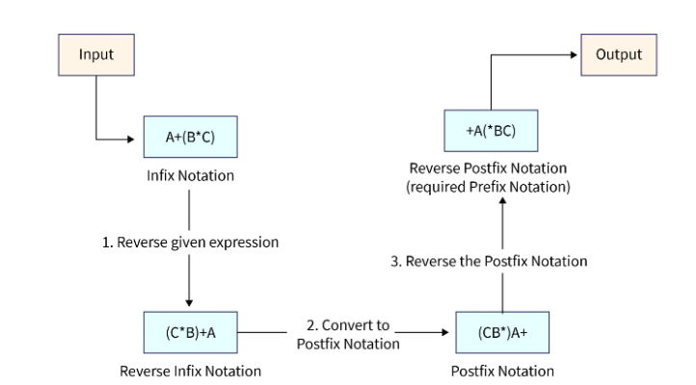
Infix to Prefix
Converting Infix Expression to Prefix Expression:
Reverse the infix expression and interchange ( with ).
Convert the reversed expression to postfix, popping only higher-precedence operators.
Reverse the obtained postfix expression to get the prefix form.
Notes:
New Courses replaced with New Programmes

Slide 19
Quick Check
1. What would be the Prefix notation for the given equation?
A^B^C^D
^^^ABCD
^A^B^CD
ABCD^^^
AB^C^D
2. What would be the Prefix notation for the given equation?
a+b-c/d&e|f
|&-+ab/cdef
&|-+ab/cdef
|&-ab+/cdef
|&-+/abcdef
Notes:
New Courses replaced with New Programmes

Slide 20
Postfix to Prefix
Conversion of Postfix to Prefix expression :
Scan the postfix expression from left to right.
If the symbol is an operand, push it onto the stack.
If the symbol is an operator, pop two operands from the stack and form a new expression as operator + operand2 + operand1, then push it back onto the stack.
Repeat until all symbols are processed.
The element at the top of the stack is the required prefix expression.
Notes:
New Courses replaced with New Programmes

Slide 21
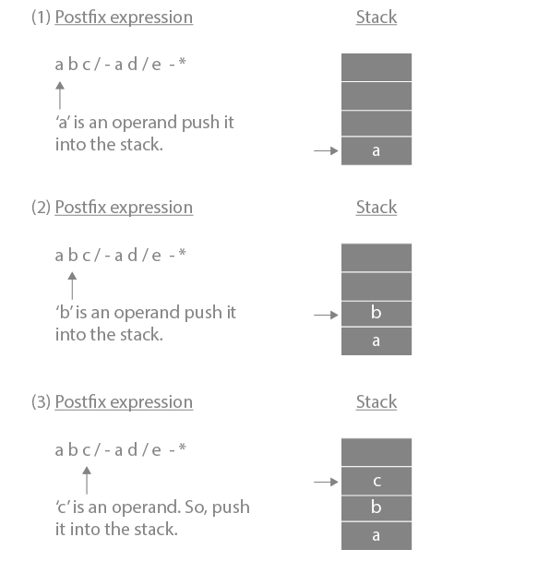
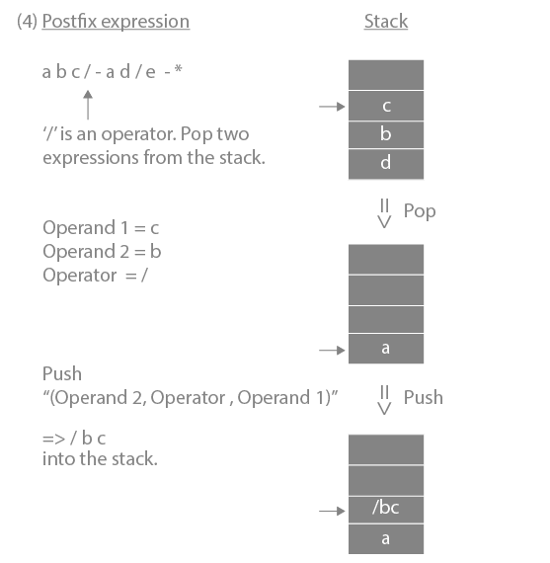
Postfix to Prefix
Notes:
New Courses replaced with New Programmes

Slide 22
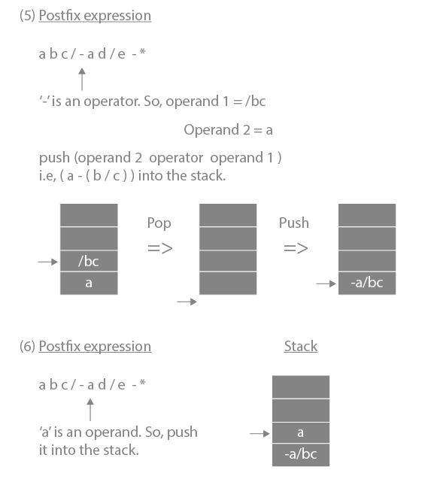
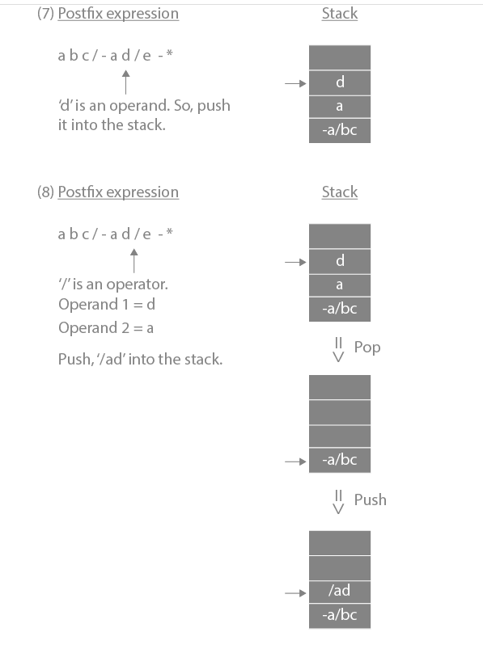
Postfix to Prefix
Notes:
New Courses replaced with New Programmes

Slide 23
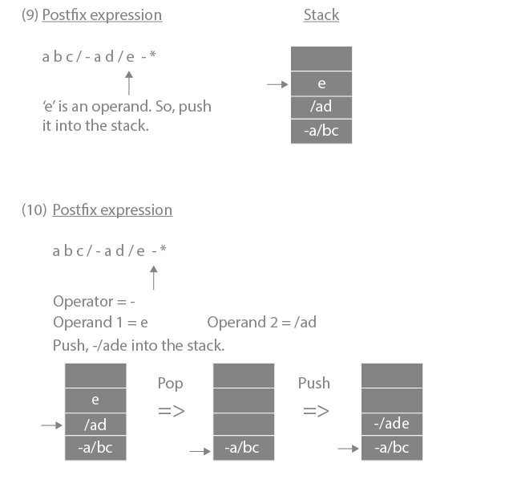
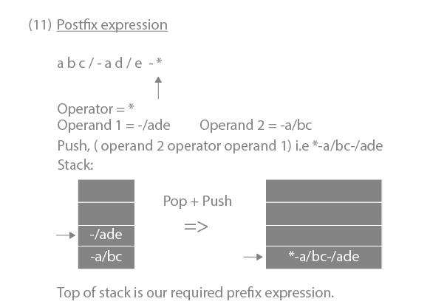
Postfix to Prefix
https://www.prepbytes.com/blog/stacks/postfix-to-prefix conversion/#:~:text=For%20converting%20Postfix%20to%20Prefix,will%20be%20our%20prefix%20expression%20.
Notes:
New Courses replaced with New Programmes

Slide 24
Postfix to Infix
Scan the postfix expression from left to right.
If the symbol is an operand, push it onto the stack.
If the symbol is an operator, pop two operands, form (operand2 operator operand1), and push it back.
After processing all symbols, the stack top contains the required infix expression.
Notes:
New Courses replaced with New Programmes

Slide 25
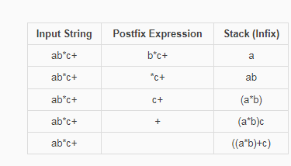
Postfix to Infix
Notes:
New Courses replaced with New Programmes

Slide 26
Prefix to Infix converter step by step
Scan the prefix expression from right to left.
If the symbol is an operand, push it onto the stack.
If the symbol is an operator, pop two operands, form (operand1 operator operand2), and push it back.
After scanning all symbols, the stack top gives the required infix expression.
Notes:
New Courses replaced with New Programmes

Slide 27
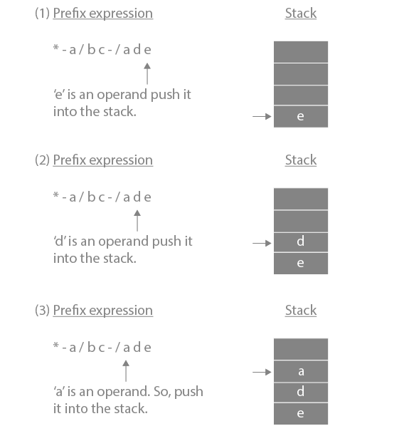
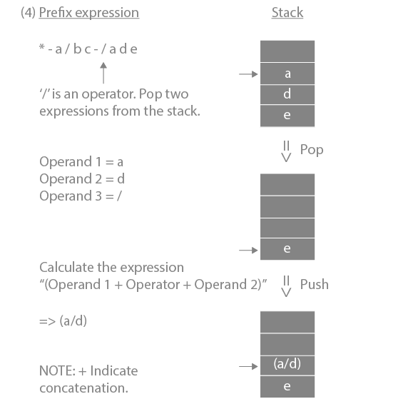
Prefix to Infix converter step by step
Notes:
New Courses replaced with New Programmes

Slide 28
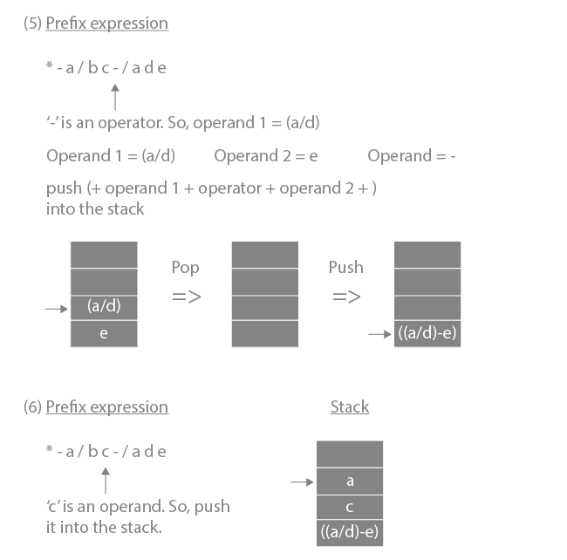
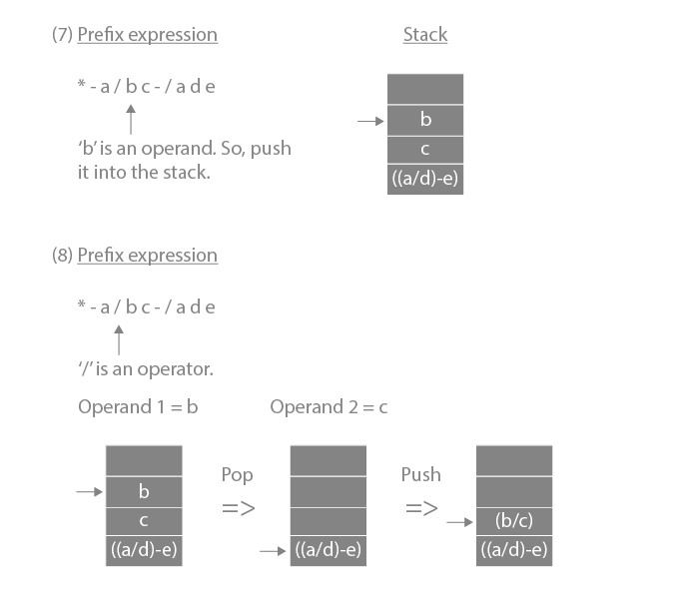
Prefix to Infix converter step by step
Notes:
New Courses replaced with New Programmes

Slide 29
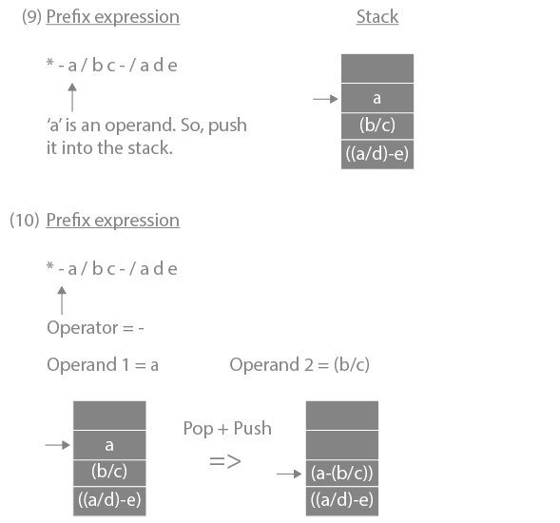
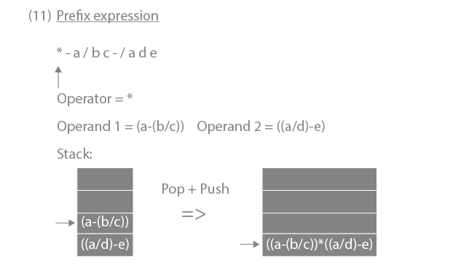
Prefix to Infix converter step by step
https://www.prepbytes.com/blog/stacks/conversion-of-prefix-expression-to-infix-expression/
Notes:
New Courses replaced with New Programmes

Slide 30
Prefix to Postfix converter step by step
Scan the prefix expression from right to left.
If the symbol is an operand, push it onto the stack.
If the symbol is an operator, pop two operands, form operand1 + operand2 + operator, and push it back.
After processing all symbols, the stack top contains the required postfix expression.
Notes:
New Courses replaced with New Programmes

Slide 31
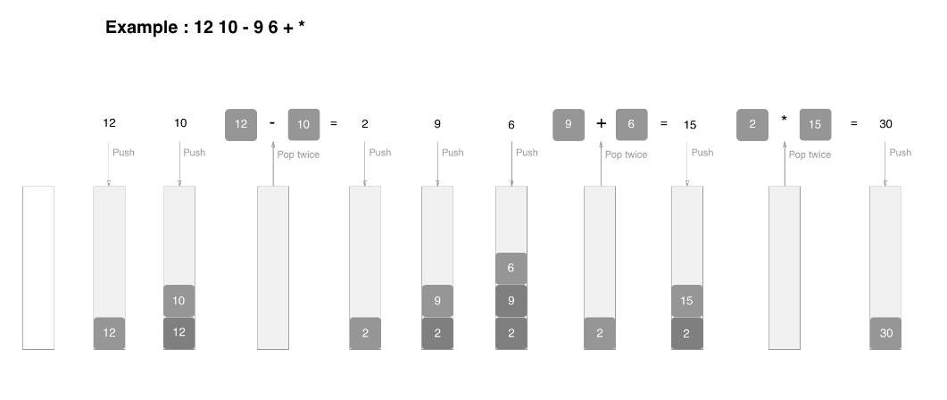
Postfix Evaluation Example
Notes:
New Courses replaced with New Programmes

Slide 32
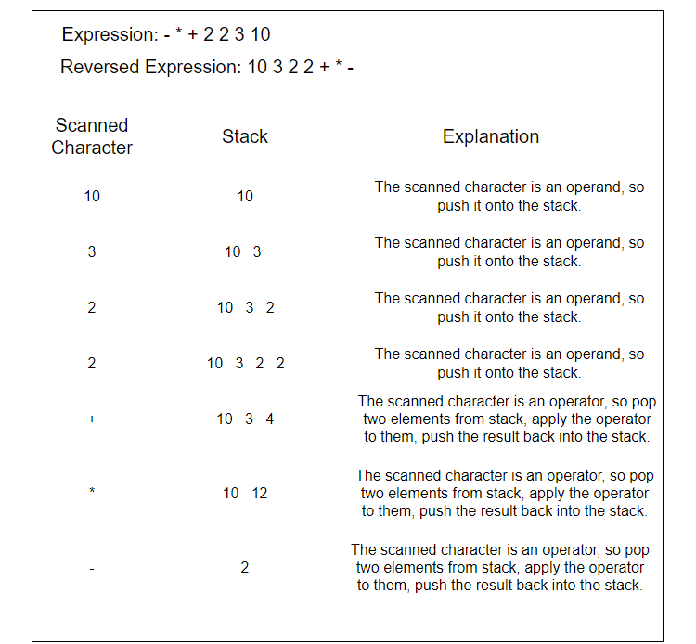
Prefix Evaluation Example
Notes:
New Courses replaced with New Programmes

Slide 33
Infix Expression to Postfix Expression
Question: Validate the given expression: 69 ^ 87 - 67 / 29 + 77 * 44
Step 1: ( 69 ^ 87 ) - 67 / 29 + 77 * 44 Note: Since ^ has highest priority it is parenthesized first.
Step 2: ( 69 ^ 87 ) - ( 67 / 29 ) + 77 * 44 / and * have the next priority but / is parenthesized first because they follow left associativity.
Step 3: ( 69 ^ 87 ) - ( 67 / 29 ) + ( 77 * 44 ) / and * have the next priority but * is parenthesized second because they follow left associativity.
Step 4: ( ( 69 ^ 87 ) - ( 67 / 29 ) ) + ( 77 * 44 )
Step 5: ( ( ( 69 ^ 87 ) - ( 67 / 29 ) ) + ( 77 * 44 ) )
Notes:
New Courses replaced with New Programmes

Slide 34
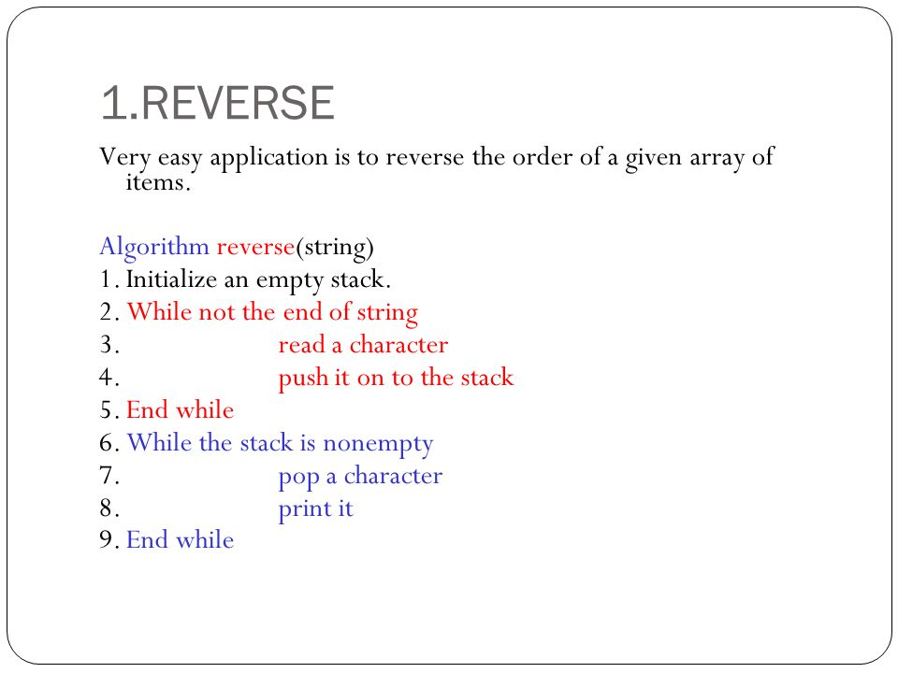
Reverse a Data
Notes:
New Courses replaced with New Programmes

Slide 35
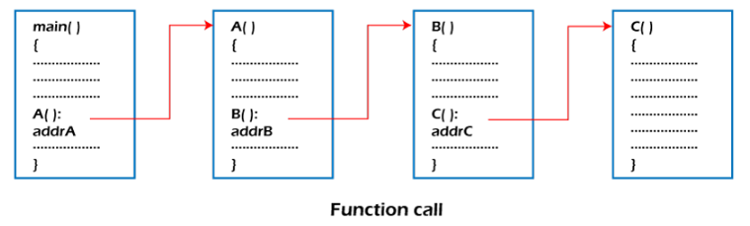
Function Calls
A stack is used to manage function calls in a program.
If function A calls B and B calls C, each function’s information is pushed onto the stack and popped after execution in reverse order.
Notes:
New Courses replaced with New Programmes

Slide 36
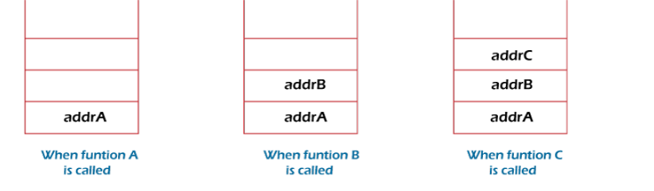
Function Calls
Consider addrA, addrB, addrC be the addresses of the statements to which control is returned after completing the function A, B, and C, respectively.
Notes:
New Courses replaced with New Programmes

Slide 37
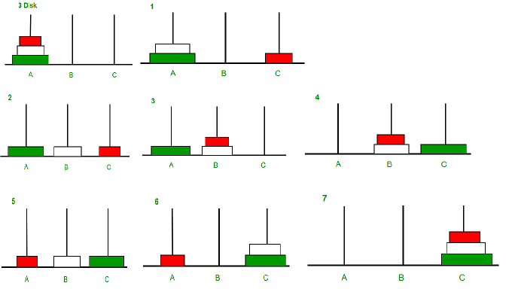
Tower of Hanoi Problem
https://www.geeksforgeeks.org/c-program-for-tower-of-hanoi//
Notes:
New Courses replaced with New Programmes

Slide 38
Tower of Hanoi Problem
Calculate the total number of moves required i.e. "pow(2, n) - 1" here n is number of disks.
If number of disks (i.e. n) is even then interchange destination pole and auxiliary pole.
for i = 1 to total number of moves:
if i%3 == 1: legal movement of top disk between source pole and destination pole if i%3 == 2: legal movement top disk between source pole and auxiliary pole if i%3 == 0: legal movement top disk between auxiliary pole and destination pole
Notes:
New Courses replaced with New Programmes

Slide 39
Code for Tower of Hanoi
void towerOfHanoi(int n, char from_rod, char to_rod,
char aux_rod)
{
if (n == 0) {
return;
}
towerOfHanoi(n - 1, from_rod, aux_rod, to_rod);
cout << "Move disk " << n << " from rod " << from_rod
<< " to rod " << to_rod << endl;
towerOfHanoi(n - 1, aux_rod, to_rod, from_rod);
}
Complete code here
Notes:
New Courses replaced with New Programmes

Slide 40
Test Yourself
1. What is the postfix representation of the following infix expression?
(A + B) * C – D * E / F
A B + C * D E * F – /
A B * C + D E * F / –
A B + C – D E * F / *
A B + C * D E * F / –
2. The result evaluating the postfix expression 10 5 + 60 6 / * 8 − is
284
213
142
71
Notes:
New Courses replaced with New Programmes

Slide 41

Key Takeaways
Stack is widely used because of its LIFO behavior.
Expression conversion and evaluation become simple using stack.
Stack helps manage function calls and recursion via the call stack.
Backtracking problems like Tower of Hanoi rely on stack/recursion.
Stack is useful in reversing data, checking balanced parentheses, and parsing expressions.
Notes:
New Courses replaced with New Programmes

Slide 42
References
Textbooks
Cormen, T. H., Leiserson, C. E., Rivest, R. L., & Stein, C., Introduction to Algorithms, MIT Press.
Lipschutz, S., Schaum’s Outline of Data Structures with C++, McGraw-Hill Education.
Reference Books
Weiss, M. A., Data Structures and Algorithm Analysis in C++, 5th Edition, Pearson Education.
Skiena, S. S., The Algorithm Design Manual, 3rd Edition, Springer.
Online Resources
https://practicepaper.in/gate-cse/stack
https://www.geeksforgeeks.org/introduction-to-stack-data-structure-and-algorithm-tutorials/?ref=lbp
https://www.javatpoint.com/data-structure-stack
https://www.fullstack.cafe/interview-questions/stacks
https://www.interviewkickstart.com/learn/stack-data-structure
https://www.youtube.com/watch?v=HRDHgKrYHgU
https://www.youtube.com/watch?v=Ci9jZSRn3os
https://www.udemy.com/topic/data-structures/
Notes:
New Courses replaced with New Programmes

Slide 43
THANK YOU

